Slide 1
Quantative Analysis of Stocks

Slide 2
Team 2
Austin Mean
Amrita Prithiani

Slide 3
Project analysis slide 2
Project Analysis
Gathering Data
General Information
about Stocks
Quantitative Stocks Analysis
Getting User Inputs
Fundamental Analysis
Choice Options for User
Technical Analysis

Slide 4
Project analysis slide 3
Project Analysis
Yahoo Api
User Inputs
Choice
options
Fundamental
Analysis
Technical
Analysis
1 wide range of data
2 Quick and easy 3Algotrading101
Blog
4 Investopedia
Gives user the ability to return data on multiple stocks at once
Gives the ability to select a range of options from a given list
PE Ratio:
Income statements:
Dividend Yields:
Earnings reports:
Close price performance:
Volatility:
Risk and Risk Returns

Slide 5
General information about stocks:
A - Show weekly historical data of the 5 stocks and S&P over last 6 months.
B - Show me last 6 months of weekly closing prices for chosen stocks.
C - Get current price of your chosen stocks.
Fundamental data analysis:
D - Show P/E ratio of the stocks you chose.
E - Show dividend yields for the stocks you've chosen.
F - Show income statements from last 4 years for the stocks you selected.
G - Get Earnings reports and analyst forecasts.
H - Get book ratio of stocks you have chosen.
I - Get fundamental data table.
Technical analysis:
J - Run series of daily return and cumulative return plots on your chosen stocks.
k - Find standard deviation, Average annual return, Show Sharpe ratios and betas in hvplots.
Q - Quit the program
''')
choice = (input('''\nPlease enter your choice (e.g. for the first option type "A"): '''))
print(choice)

Slide 6
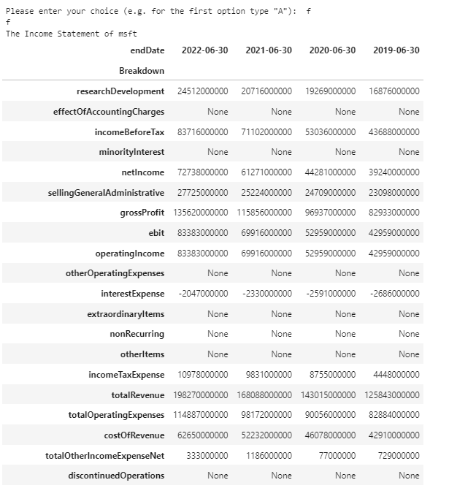

Slide 7
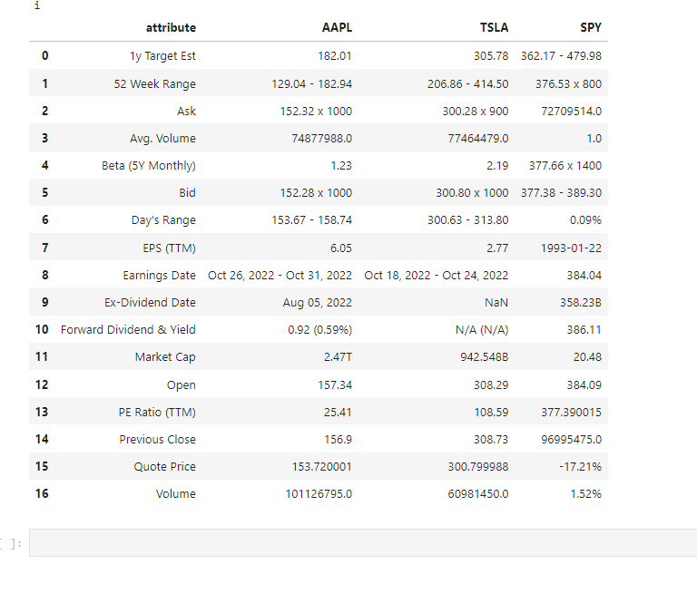

Slide 8
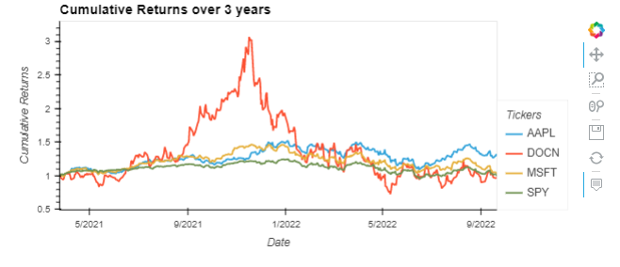

Slide 9
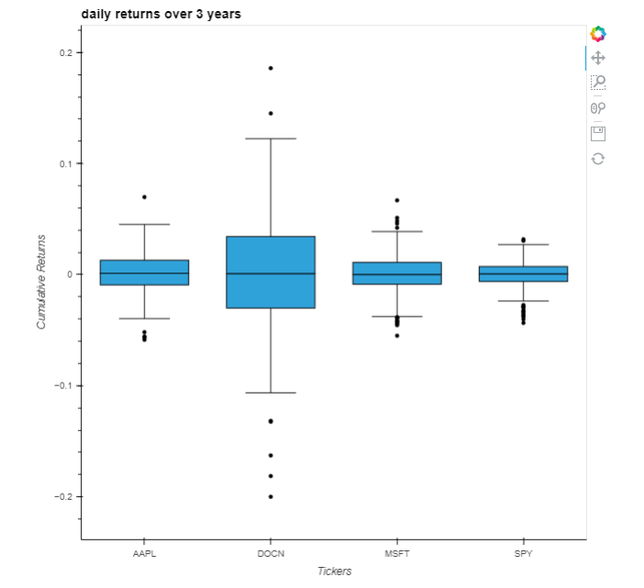

Slide 10
Thank You

